Slide 1
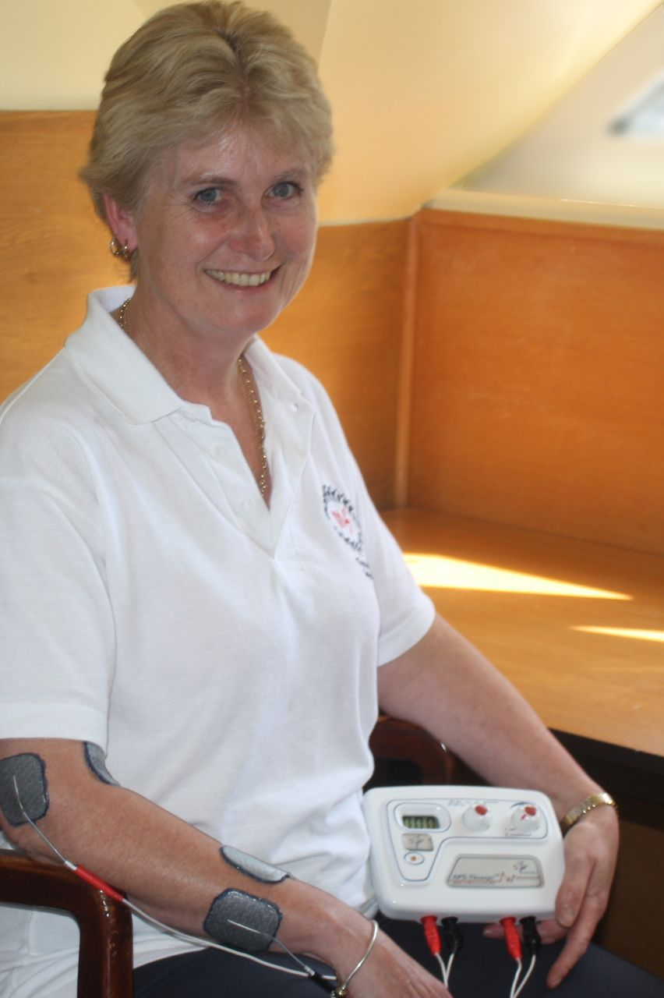
Using an APS Therapy machine
The machines run for 8 minutes & then turn off and beep.
Each treatment consists of 4 placements of the electrodes.
4 X 8 minutes = 32 mins; allow 40-45 minutes for the whole session.

Slide 2
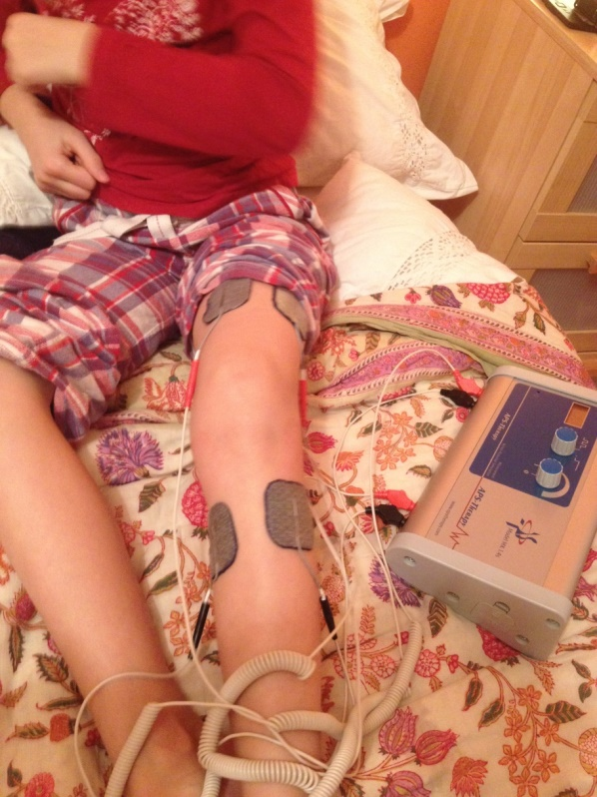
1)Treatment is between the electrodes.
Imagine a straight line going through the worst pain area.
They can be placed above and below pain
leaving a couple of inches on each side
Or through, in front and behind,
directly over pain.
Example – above and below knee

Slide 3
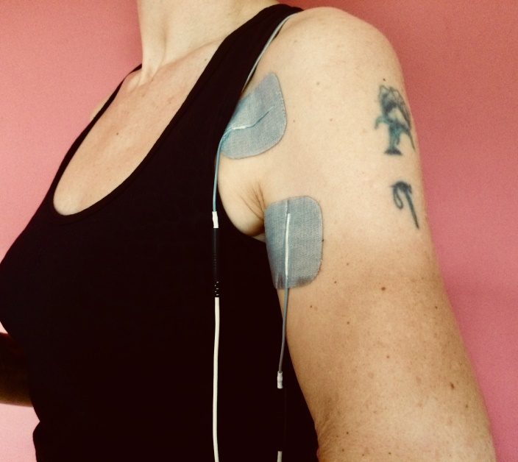
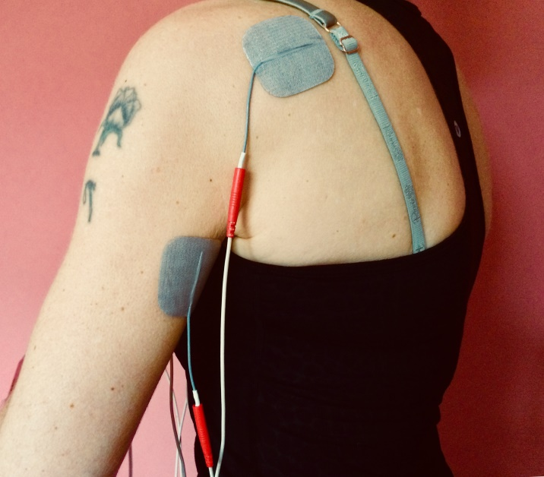
Treatment is between the electrodes
Example, through shoulder; blacks at the front, (wherever it feels worst), reds at the back.

Slide 4
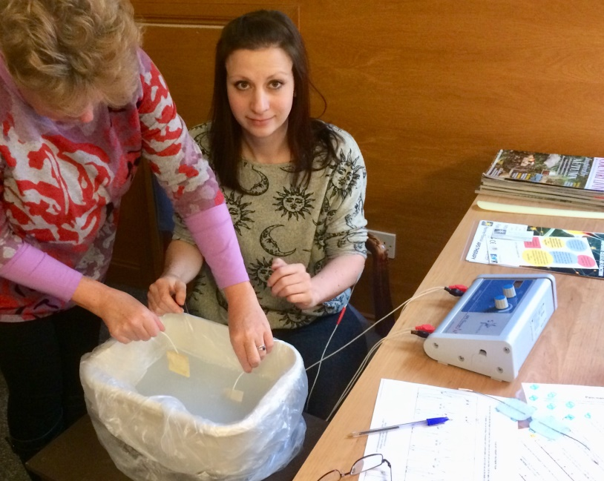
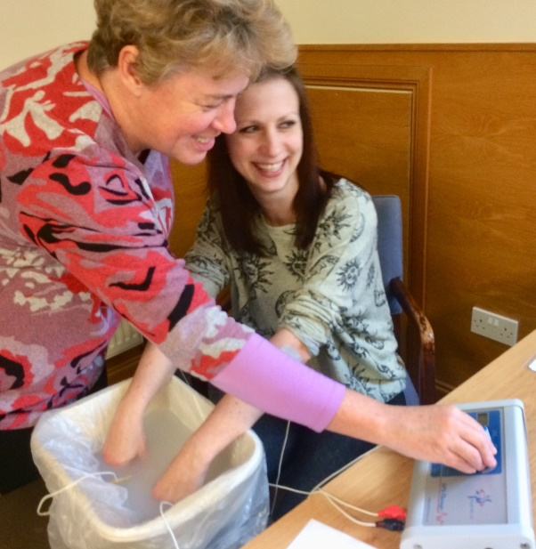
Treatment is between the electrodes
Water treatment if all fingers/toes are painful
Replace black electrodes with water electrodes,
fill plastic bowl with warm water to cover hand or foot
Add bathsalts approx 2 dessert spoons
Add hand or foot; do same process as usual

Slide 5
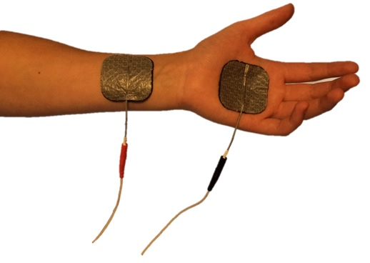
2) Current runs from blacks to reds
When working in limbs, blacks go distal ( furthest away) and reds proximal ( nearer the centre of the body)
Blacks go nearer to the pain
Reds can be couple of inches on other side of pain, or further away ( perhaps to include a lymph gland area, or another pain area) Long stretch as valid as short

Slide 6
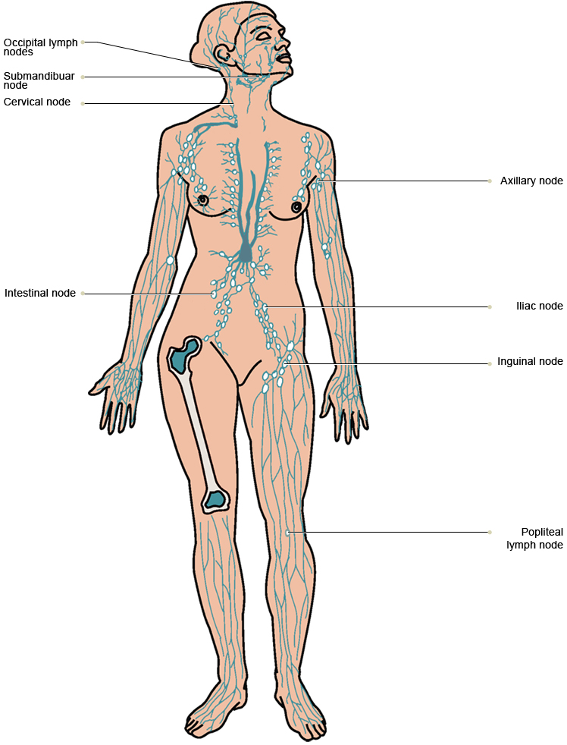
Lymph system

Slide 7
3) Electricity finds the shortest route
So only go through when this is the shortest route; eg trunk, hips, shoulders, chunky knees
On skinny joints, go up the limb, not through
Can use blacks on one side, reds on the other.

Slide 8
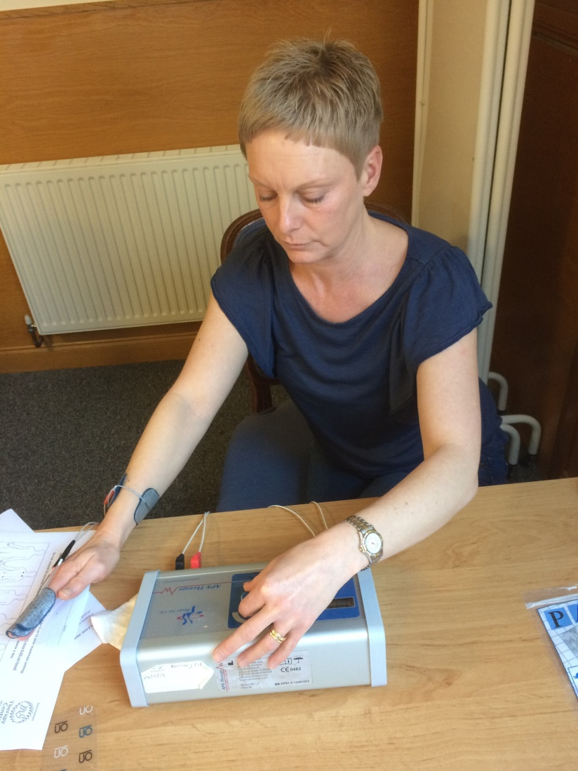
How to use the machines
Check on continuous
Cleanse skin
Place electrodes
Turn it on
Turn it up
Feel the tingle
Turn it down by 2/3rds;
check age related max.

Slide 9
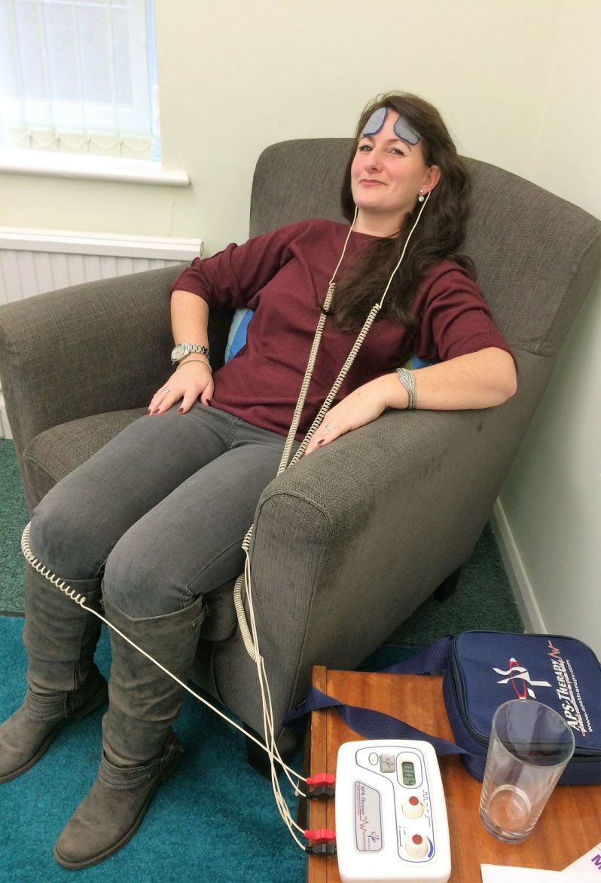
Exception: head treatment
For headaches, migraine insomnia, ?depression
Earclips are available, need thorough moistening before use.
Or use skin electrodes: blacks above eyebrows,
Tuck cords behind ears to help stay on
Reds at top or bottom of spine, or on shoulders
Max 0.05, avoid temples.

Slide 10
After first week / 3 treatments
If no side effects ( headaches, nausea ):
Relax about age related max
And If not getting results already:
Allow it to be used at higher amperage, but comfortable
To a max of .60
.60 is optimal for ATP production ( energy)
Particularly important for fatigue
Can still get complete results on very low settings
After 6-9 sessions, if no result, tweak treatment plan
Or try pulsed mode – set level, then switch to pulsed.

Slide 11
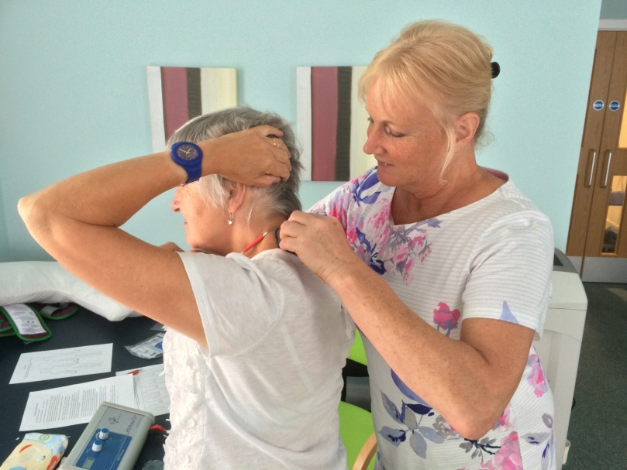
Overview of a session
1) Spine; blacks on each side of c7 (nobbly vertabra), 1 pads width either side,
reds same, around level of dimples before buttocks
2) Priority painful area
3) Priority pain area – can be different approach to it
4) Whole body ( palms & soles); blacks in the half of the body with problem

Slide 12
Session 1 Practitioner checklist:
Check happy to start, any questions before?
Start: – check on continuous mode, switched off
If client to treat, guide them to apply & assess ability
First treatment, top of spine & bottom, either side.
Cleanse skin
Attach electrodes to cords
Place on either side of spine, blacks at top, reds bottom
Turn on til clicks
Turn up slowly until a tingle is felt
Turn down by ½ to 2/3rds
Check age related max and adjust again if necessary

Slide 13
Session 1 Practitioner checklist
Leave until beeps, use 8 mins to make treatment plan
When beeps, turn to off
Move to priority painful area – can be spine- same process. Use time to assess pain
Apply symmetrically, with imaginary line through pain
Can be up/down, side to side, or through body
Only avoid temporal lobes/temples
Can do this treatment twice, or change
4th placement always whole body; palms & soles
Give treatment plan & electrodes; check they understand
Book course of sessions for your client

Slide 14
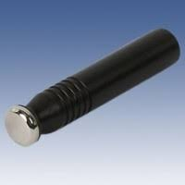
Applicator
Comes with clinic machine
Or separate purchase
Use with gel
Can work in more deeply
& Move about whilst treating
Usual principles apply:
Attach red electrodes to skin as usual
Apply gel to problem area
Hold applicator in 1 area until sensation felt; turn down
Massage over area whilst treating

Slide 15
Electrodes
PALS Platinum – direct current
Remove and seal in bag on plastics each time
Pick up by corner, don’t pull tails
Cleanse skin to preserve life of electrodes
Shave area if too hairy to stick down
Few drops of water if getting dry, before sealing in bag
Store at room temperature

Slide 16
Maintenance & care
Does not need routine servicing
Best quality rechargeable 9V batteries
Change daily in clinic setting
2 year warranty on machine
Cords are only part susceptible to damage
Won’t start – check battery, temperature, circuit, pads
Slow to turn up – resistance - go slower
Check mode; on pulsed?

Slide 17

Thankyou & contacts
Miranda Olding RGN MSCN MCMA
Beds & Northants MS Therapy Centre
www.painfreepotential.co.uk www.mirandasmsblog.com
01908 799870
Stay in touch for news and offers
Twitter
LinkedIn
miranda@painfreepotential.co.uk

